Slide 1


$CO_{2}$ Flux experiment
Comparison between 2 different rooms

Slide 2

Introduction
We assume the plans have effect on the $co_{2}$ levels in the room. In this experiment we look on the differences in $CO_{2}$ levels between room with plants and a room without plants.
The spaces examined are laboratories of the same size, one of which has a green wall with vegetation, and one does not. We released $CO_{2}$ at a constant and identical rate in both spaces (at different times) when the gas cylinder was in the same relative position as well as the sensor for measuring carbon dioxide levels. The spaces were empty of people. The temperature and relative humidity in the center of the room were also measured.

Slide 3

Technical details
Experiment 1 (room without plants): 22/02/2022 15:55–
Temp/RH sensor- sensor 11, $CO_{2}$ start 640 ppm
Experiment 2 (room without plants): 24/02/2022–
Temp/RH sensor- sensor 11, $CO_{2}$ start 530 ppm
Experiment 3 (room without plants): 27/02/2022 10:10 -
Temp/RH sensor- sensor 11, $CO_{2}$ start ppm
When I changed to second regulator, I apply just 5 minutes

Slide 4
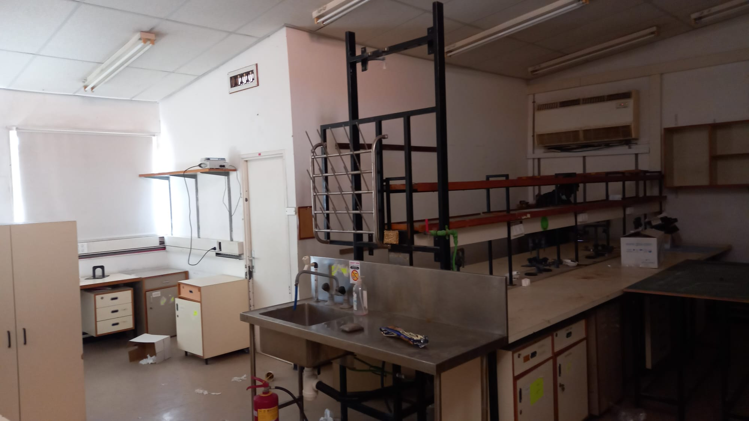
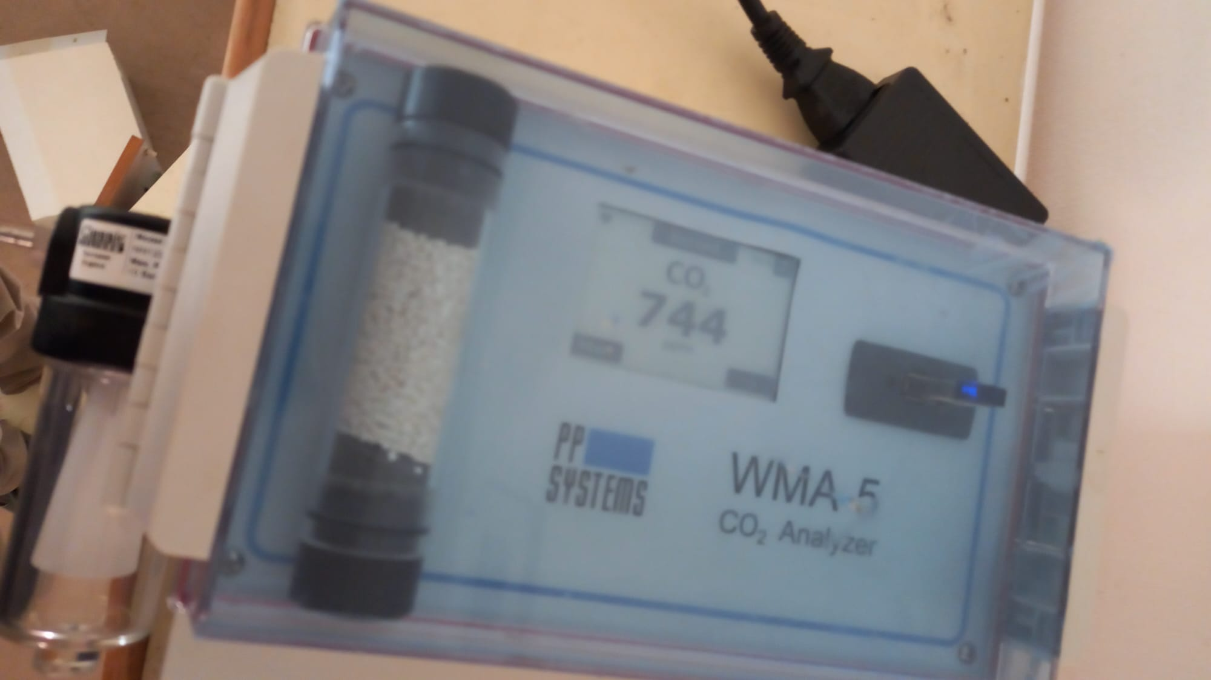
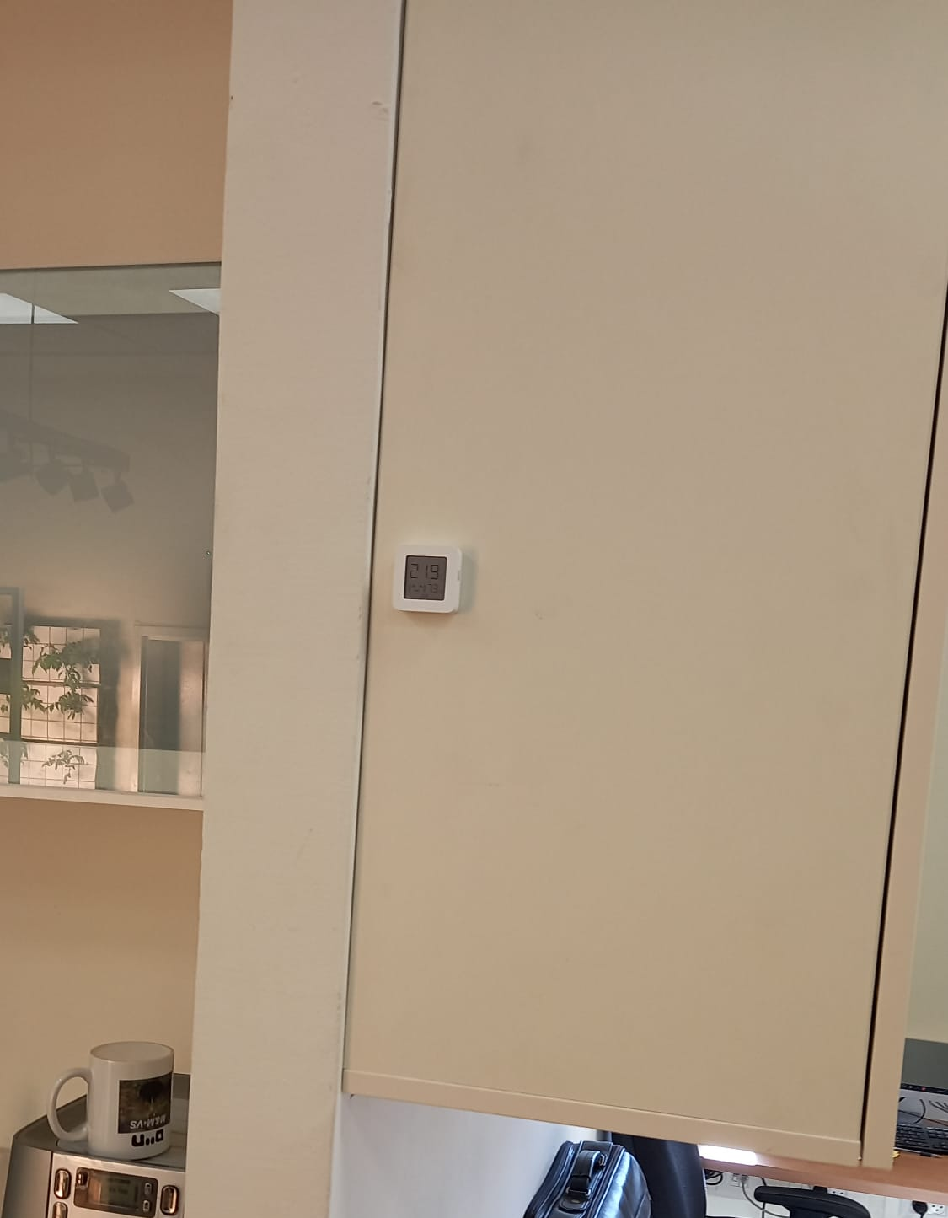




images
Temp/RH$sensor$
$$co_{2} sensor$$
$CO_{2}$ cilinder
$CO_{2}$ at the start
Original place sensor

Slide 5

Methodology
Data:
$CO_{2}$ in with gas analyzer, resampled to 1 min.
$CO_{2}$ out interpolate after 30 min resample.
Temperature sensor -

Slide 6
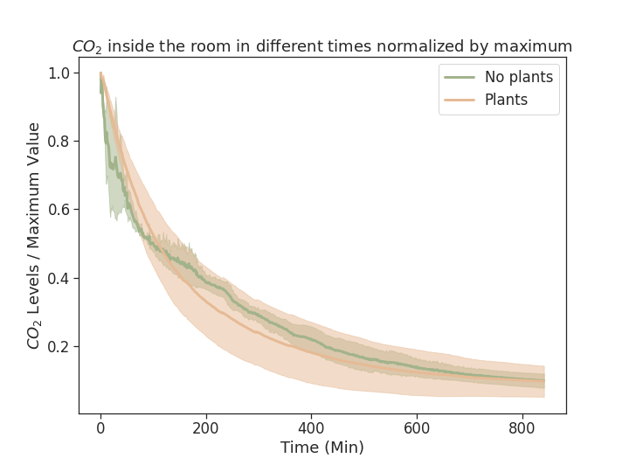


Results
$CO_{2}$in
$CO_{2}$in - $CO_{2}$ out

Slide 7
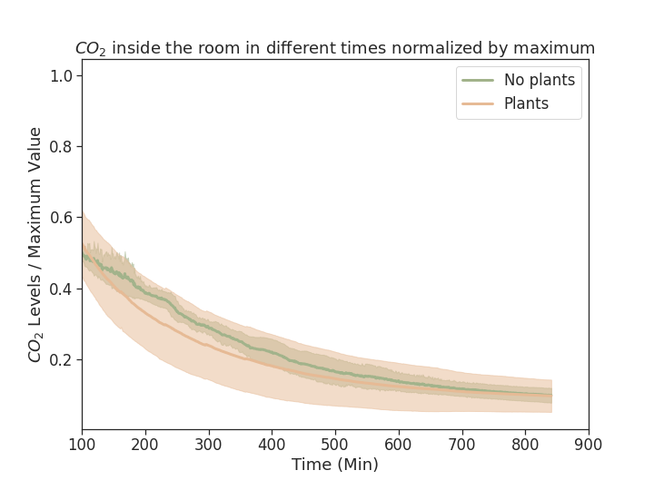
Results
$CO_{2}$in
$CO_{2}$in - $CO_{2}$ out

Slide 8
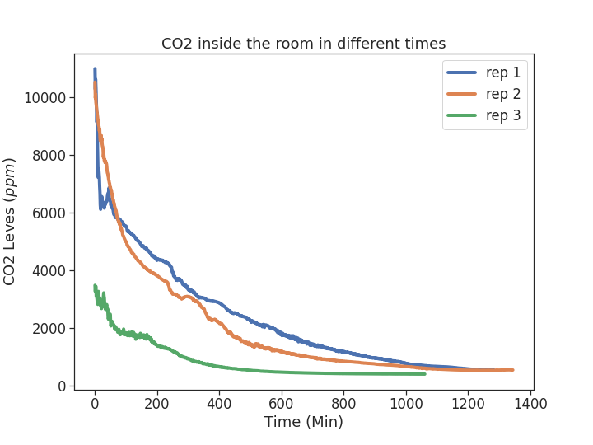
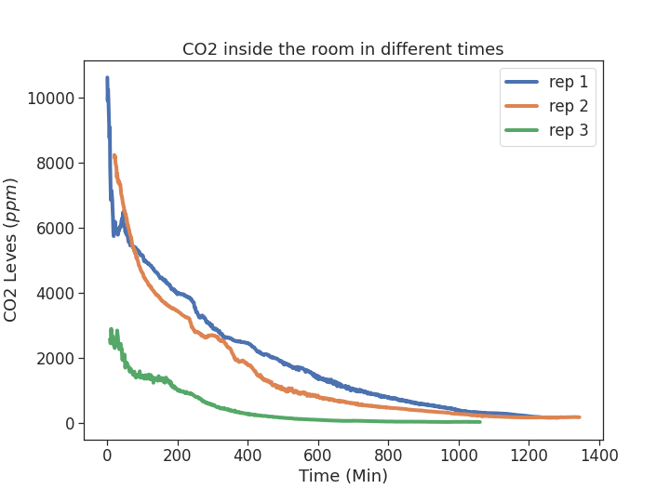
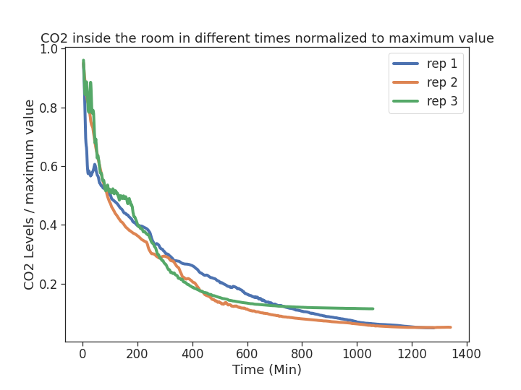
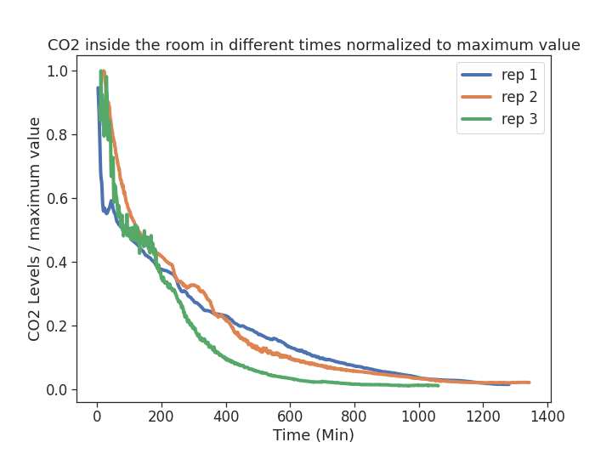




$$CO_{2} no plants$$
$CO_{2}$no plants -$CO_{2}$ out
$$Not normalized$$
$$Normalized$$

Slide 9
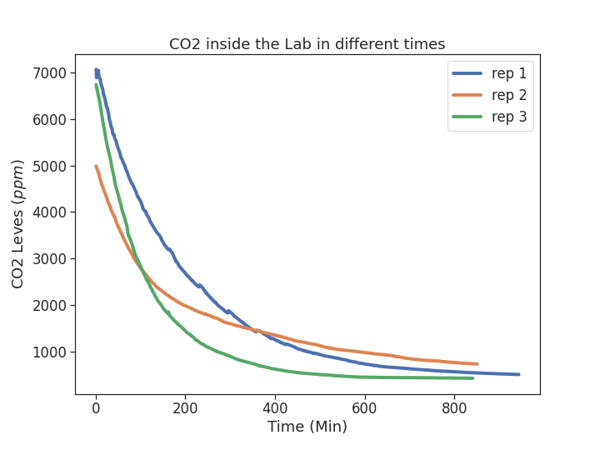
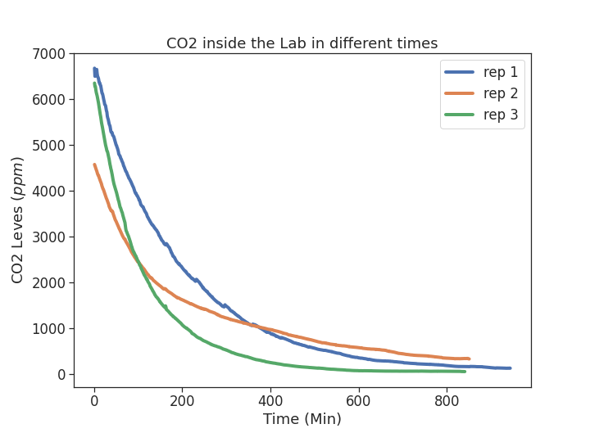
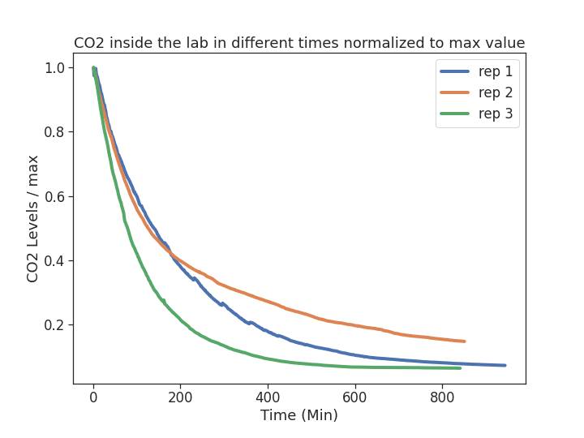
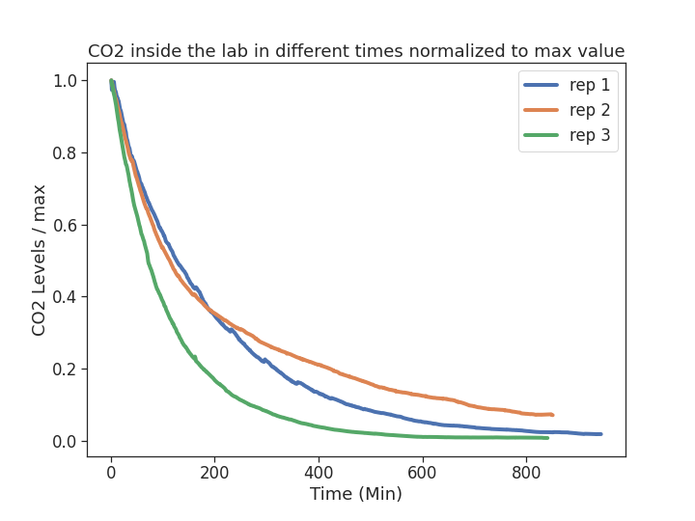


$CO_{2}$in lab
$CO_{2}$in lab- $CO_{2}$ out
$$Not normalized$$
$$Normalized$$

Slide 10
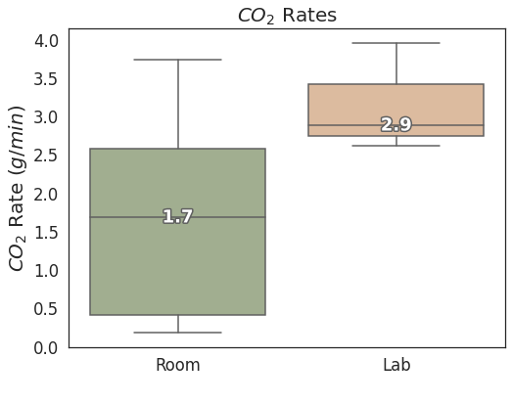
Results
A
B

Slide 11
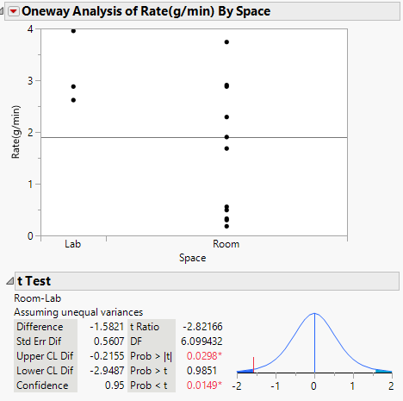
Results- T test

Slide 12
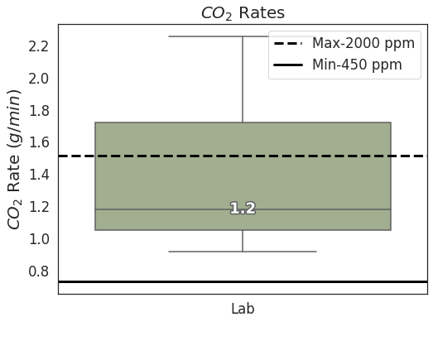
Results

